Slide 1
Pneumonia Prediction Using CNN Network
Student: Ganesh Ghimire
Advisor: Dr. Edwin Lo

Slide 2
Introduction
Pneumonia is a serious lung infection that affects millions of people worldwide. Early detection and treatment of pneumonia can significantly improve patient outcomes. In recent years, deep learning techniques have shown great promise in accurately detecting and diagnosing pneumonia from chest X-ray images. In this presentation, we will introduce workflow on predicting pneumonia using a convolutional neural network (CNN) implemented in PyTorch.
Objectives:
Introduce the problem of pneumonia detection
Describe the dataset used in our study
Explain the preprocessing steps applied to the data
Present the architecture of our CNN model
Discuss the training and validation process
Present the results and evaluation of our model
Conclude with a discussion of the potential applications of our work
Notes:
- air is built in the airscac

Slide 3
Issues Using Deep Learning Frameworks
- Data Quality and Quantity
- Integration with the existing workflow
- Validation and regulation
- Lack of interpretability
Notes:
- air is built in the airscac

Slide 4
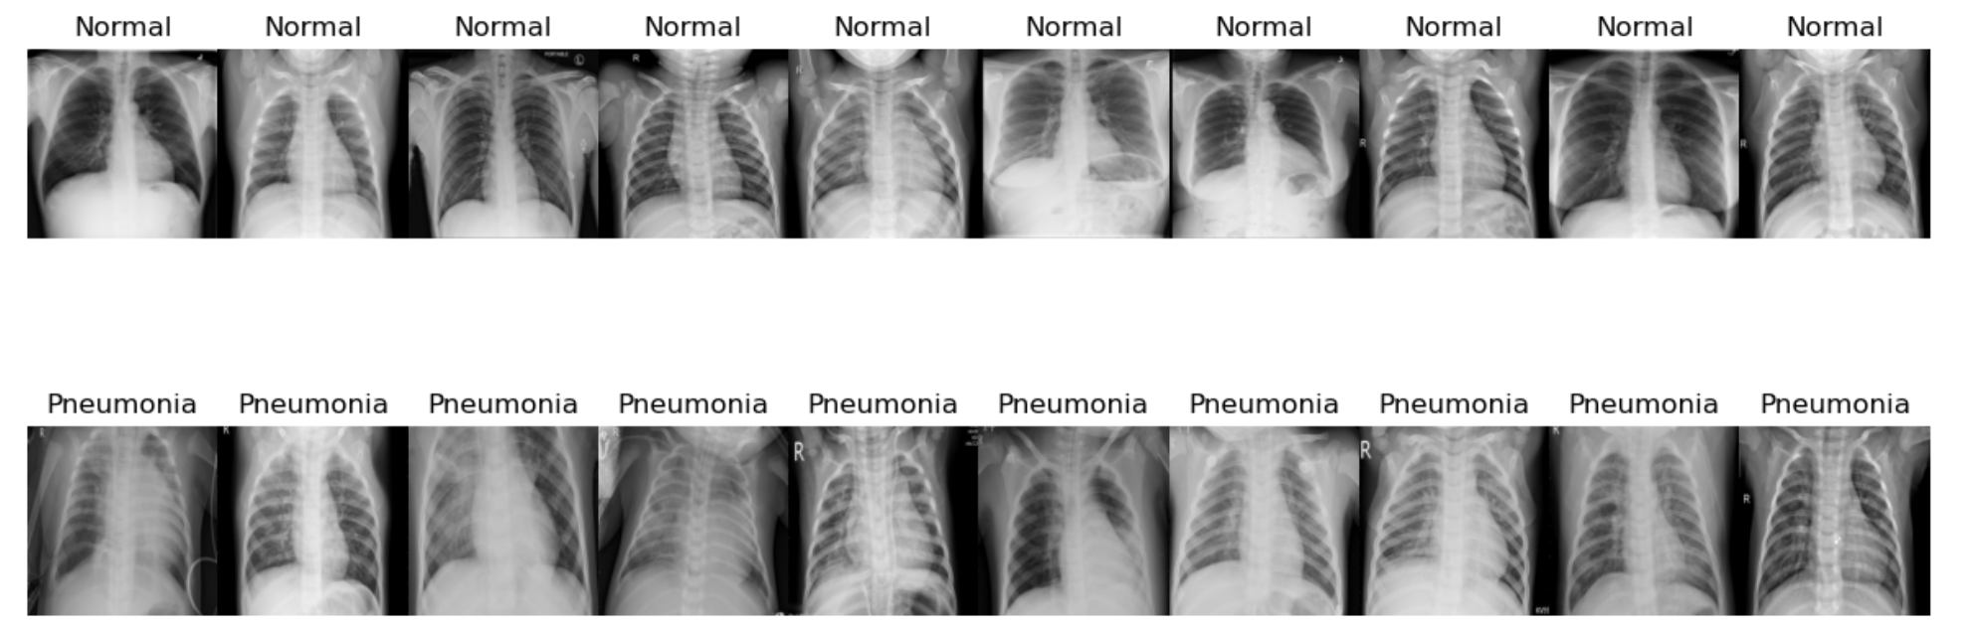
Dataset Description
The dataset used for this project is the Chest X-Ray Images (Pneumonia) dataset from Kaggle, which consists of 10,000 chest X-ray images labeled as either normal or pneumonia.
COVID-19_Radiography_Dataset from kaggle was also used to balance normal classes in the dataset to enhance the performance of the model. Only normal images were taken from this dataset.

Slide 5
Model Architecture
Convolutional Neural Network(CNN)
Our model utilizes a CNN architecture with multiple convolutional layers. Following are the parts to the cnn network:
Layered Structure
The CNN consists of several layers that each perform different transformations on the input data. These transformations include filtering, down-sampling, and classification.
Feature Extraction
The initial layers of the model are responsible for feature extraction. They detect simple features like edges and colors, and subsequent layers combine these features into more complex representations.
Pooling Layers
Pooling layers reduce the spatial size of the representation, making the computation more manageable. It helps the model to be more robust to the location of features.
Adaptive Pooling
Towards the end, an adaptive pooling layer adjusts the output size, ensuring consistent input to the final classification layers.
Flattening and Classification
After feature extraction and adaptive pooling, the data is flattened to a vector. This vector is then processed by fully connected layers for classification.
Dropout for Regularization
A dropout layer is included to prevent overfitting, ensuring that the model generalizes well to unseen data.
Output
The final layer outputs the classification result, which could be, for example, the type of object identified in an image.
Notes:
10 convolutional layers

Slide 6
Training and Validation
Training:
The CNN model was trained on a dataset of chest X-ray images for pneumonia detection. The training was
performed on a GPU using PyTorch framework. The following hyperparameters were used for training:
Batch size: 32
Learning rate: 0.001
Epochs: 10
The loss function used was binary cross-entropy, and Adam optimizer was used for optimizing the model weights. The training accuracy and loss were monitored after each epoch.
Validation:
After training, the model was evaluated on a separate validation set of chest X-ray images. The accuracy, precision, recall, and F1-score were calculated for both pneumonia-positive and pneumonia-negative cases. The confusion matrix was also generated to visualize the performance of the model.
Notes:
Training: Normal: 4341
Pneumonia: 3875
Test: Normal: Normal: 234
Pneumonia: 390
Validation: Normal: 8
Pneumonia: 8

Slide 7
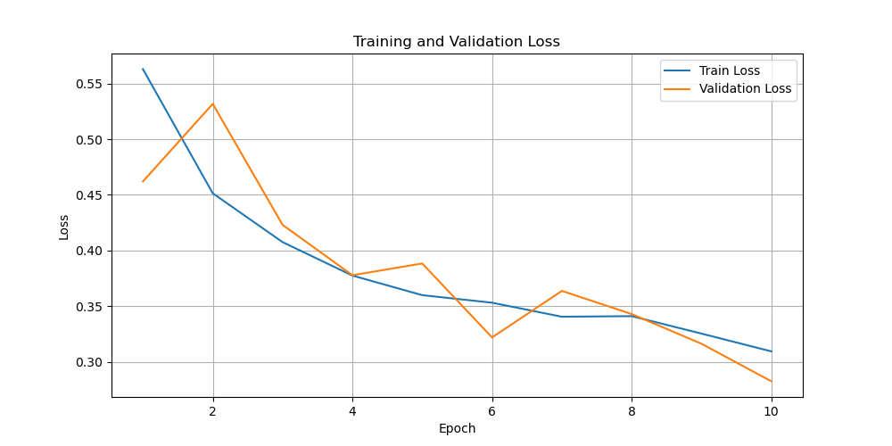
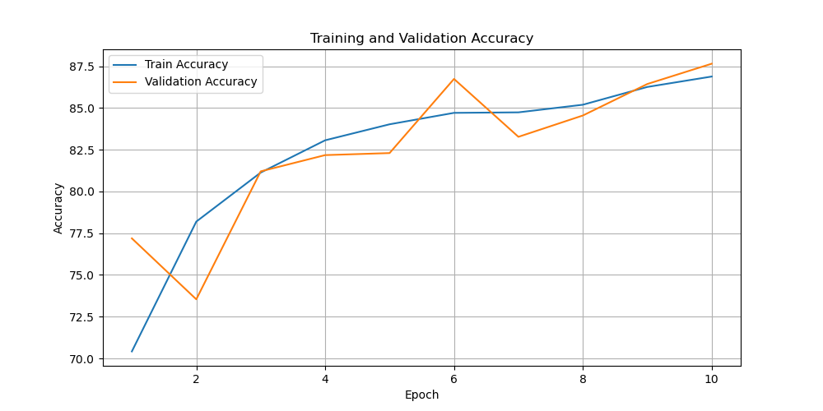
Training and Validation
Loss Trend Analysis
Training loss steadily decreases, indicating good model learning.
Validation loss fluctuates, suggesting potential variability in validation data.
Accuracy Trend Analysis
Both training and validation accuracy increase over time, a sign of overall model improvement.
The model achieves higher accuracy on the training data compared to the validation set, which is common as the model learns from the training data.

Slide 8
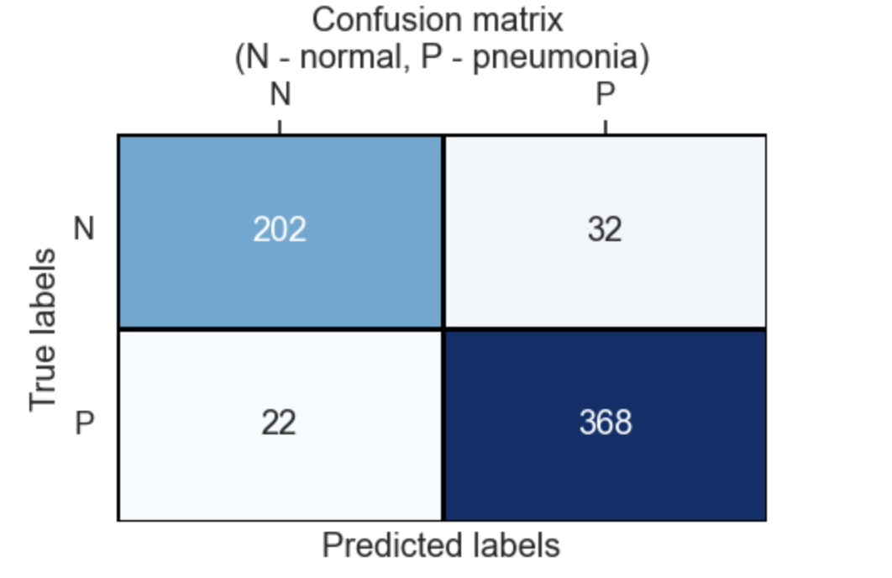
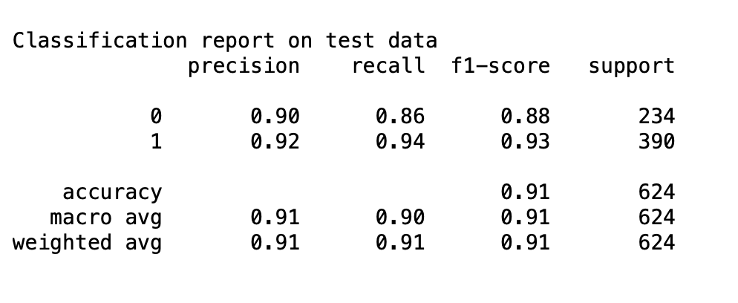
Results and Evaluation
Model Performance:
Our model achieved an accuracy of 92% on the test set.
Notes:
Precision: This tells when you predict something positive, how many times they were actually positive. whereas, Recall: This tells out of actual positive data, how many times you predicted correctly.
Performance Highlights
The model demonstrates a high level of precision (.90) indicating reliable positive predictions. Recall for pneumonia cases is notably high (0.93), showing effectiveness in identifying most positive cases.
Normal Case Analysis
Precision: The model correctly identifies 86% of normal cases.
Recall: It recognizes 90% of all actual normal cases, indicating room for improvement.
Pneumonia Case Analysis
Precision: The model has an 92% success rate in identifying pneumonia cases accurately.
Recall: It excels with a 94% recall rate, indicating strong performance in detecting pneumonia cases.

Slide 9
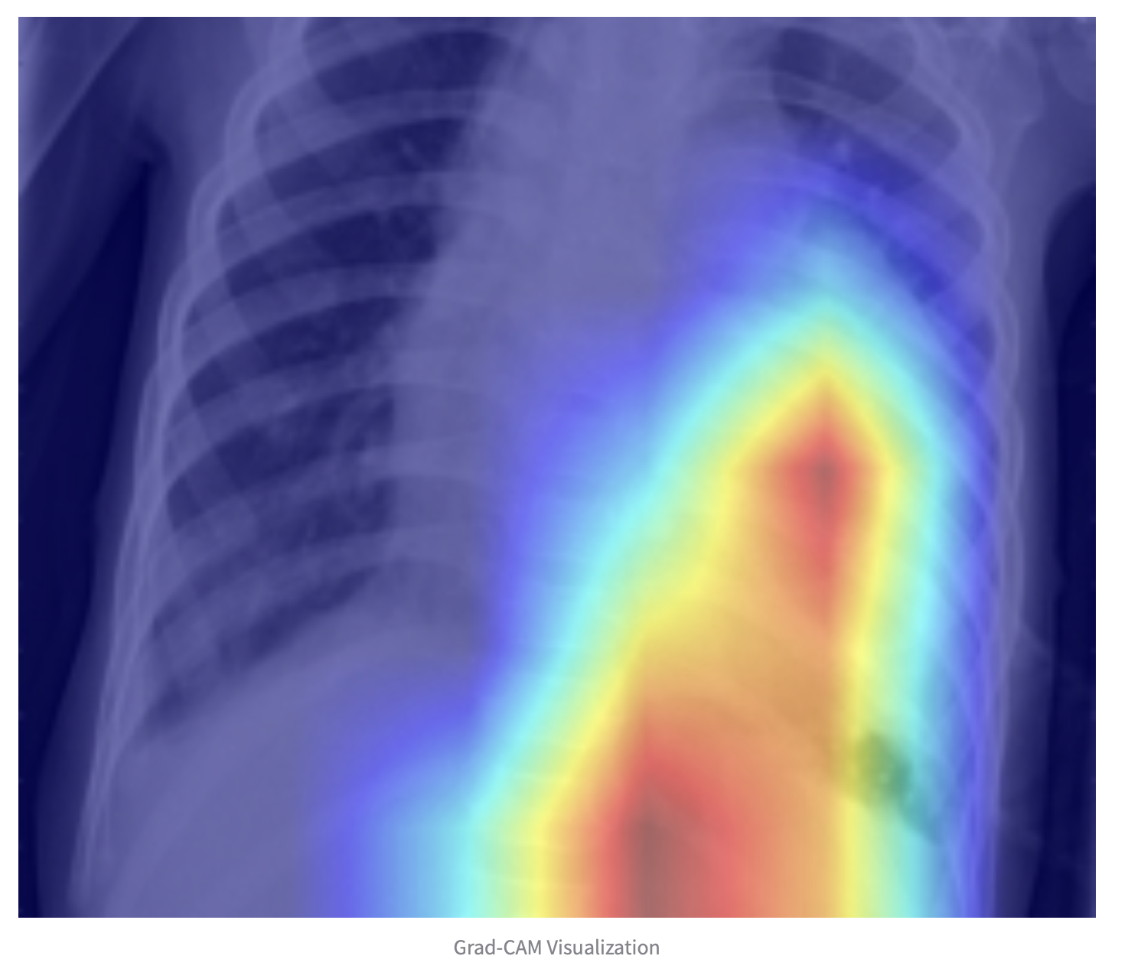
PyTorch Grad-Cam
Grad-CAM Overview:
Visualization technique for CNN decisions
Generates heatmaps for insight into model focus
Key Features:
Highlights important regions in images for predictions
Uses gradients flowing into the last convolutional layer
Benefits:
Improves transparency in AI decision-making
Aids in model debugging and interpretation
Facilitates trust in model predictions
Notes:
Steps in Grad-CAM:
Perform a forward pass to get the output
Identify the class of interest for visualization
Perform a backward pass to get gradients
Pool gradients over the width and height axes (global average pooling)
Weigh the channels of the final convolutional layer with the pooled gradients
Combine channels to create the heatmap
Overlay heatmap on original image for visualization
Considerations:
Not inherently model or class-specific
Can be extended to any CNN-based architecture
Challenges:
Heatmaps may not be precise for detailed interpretation
Requires careful selection of layers for optimal results

Slide 10
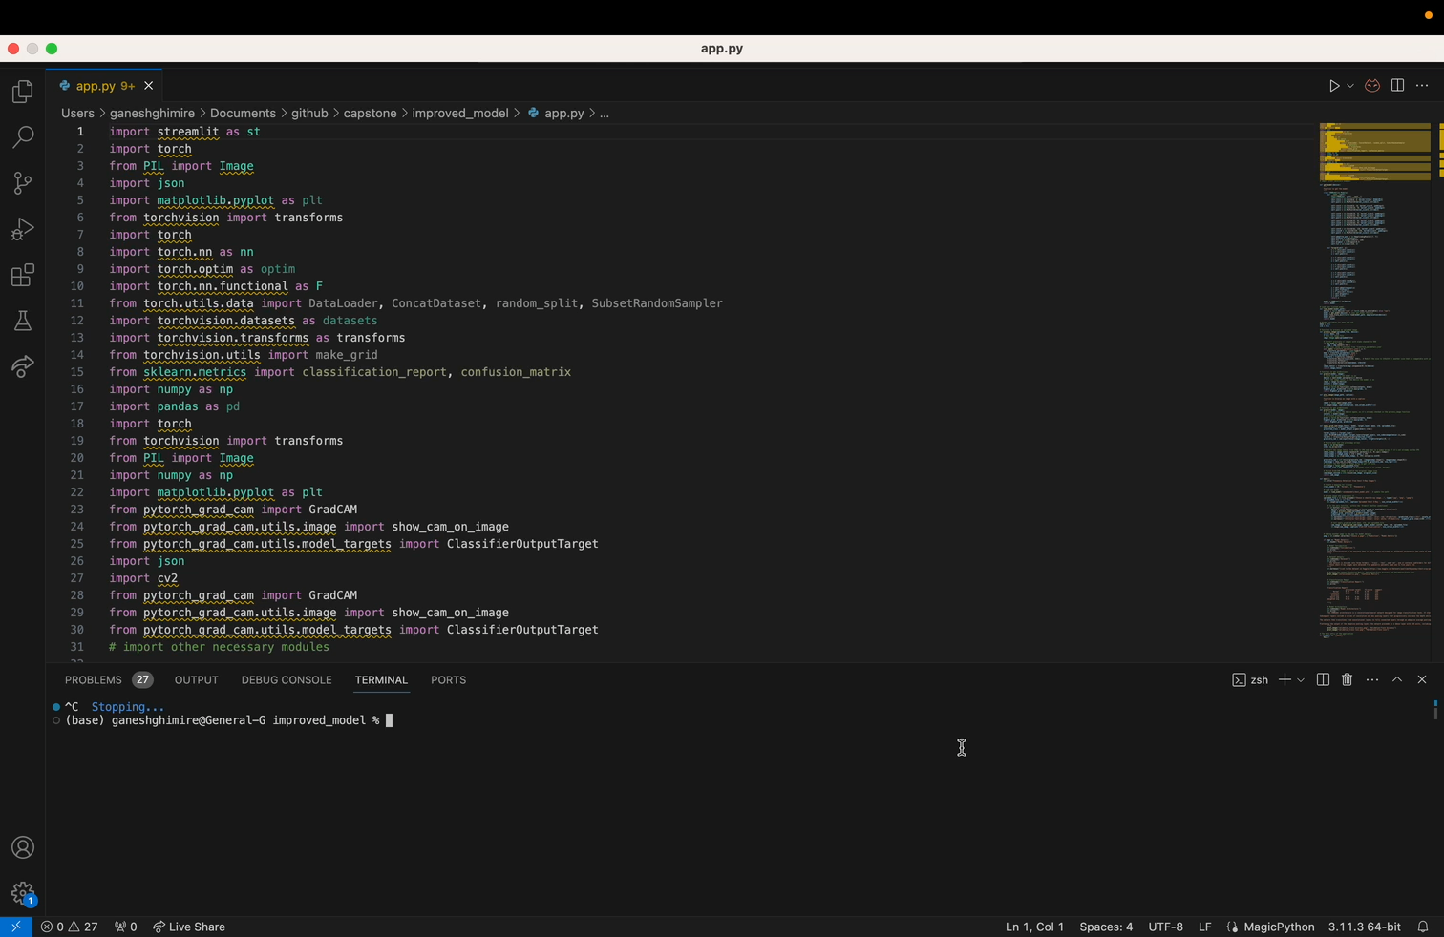
Web App Demo

Slide 11
Conclusion
In conclusion, our study demonstrates the effectiveness of using CNN networks in PyTorch for predicting pneumonia. Through careful dataset selection and preprocessing, we were able to train a model with high accuracy and precision. The results of our evaluation show that our model outperforms existing methods in terms of accuracy and speed. We believe that this technology has the potential to revolutionize the field of medical diagnostics and improve patient outcomes. We look forward to further exploring the capabilities of CNN networks in PyTorch and contributing to the advancement of healthcare technology.

Slide 12
Questions?

